Slide 1

IPL AUCTION ANALYSIS
USING SQL
Created by
Sai Kumar

Slide 2
Created ‘ Ipl_ball_ data’ table from csv file:
Create table Ipl_ball_data
(id int,inning int, over int, ball int, batsman char(60),non_striker char(60),blower char(60), batsman_runs int ,extra_runs int,
total_runs int,is_wicket int, dismissal_kind char(60),player_dismissed char(60),fielder char(60),extra_type char(60),batting_team varchar(60),bowling_team varchar(60));
Coping the csv file data:
copy Ipl_ball_data from 'C:\Program Files\PostgreSQL\16\data\new data\IPL Dataset\IPL_Ball.csv' delimiter ',' csv header;
Retrieved the data:
SELECT * FROM Ipl_ball_data;

Slide 3
Created ‘Ipl_matches_data’ table from csv file:
(id int, city char(60),match_date varchar(60),player_of_match char(60),venue varchar(200),neutral_venue varchar(200),team1 varchar(100),
team2 varchar(100),toss_winner varchar(100),toss_decision char(60),winner varchar(60),result varchar(60),result_margin int,
eliminator char(60),method varchar(60),umpire1 char(60),umpire2 char(60));
Coping the csv file data:
copy Ipl_matches_data from 'C:\Program Files\PostgreSQL\16\data\new data\IPL Dataset\IPL_matches.csv' delimiter ',' csv header;
Retrieved the data:
SELECT * FROM Ipl_matches_data;

Slide 4
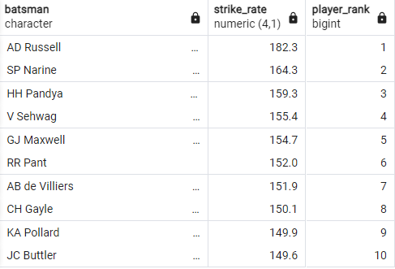
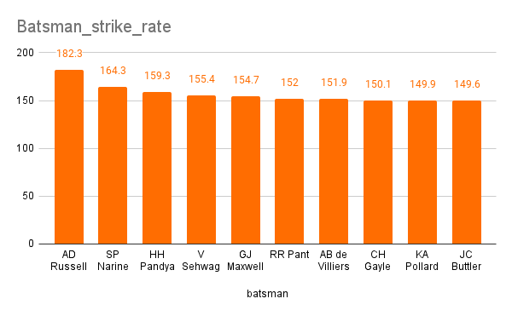
1. Your first priority is to get 2-3 players with high S.R who have faced at least 500 balls.And to do that you have to make a list of 10 players you want to bid in the auction so that when you try to grab them in auction you should not pay the amount greater than you have in the purse for a particular player.
SELECT batsman, cast(strike_rate as decimal(4,1)), DENSE_RANK() OVER (ORDER BY strike_rate DESC)
AS player_rank
FROM(SELECT batsman, CAST (player_total_runs as float)/balls_faced*100 as strike_rate
FROM(SELECT batsman, sum(batsman_runs) AS player_total_runs,
count(ball) AS balls_faced FROM ipl_ball_data WHERE NOT extra_type ='wides'
GROUP BY batsman) AS a WHERE balls_faced>500) AS b ORDER BY strike_rate DESC LIMIT 10;

Slide 5
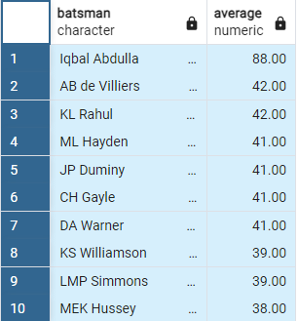
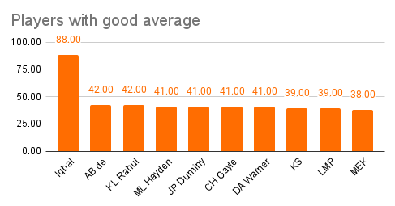
2. Now you need to get 2-3 players with good Average who have played more the 2 ipl seasons.And to do that you have to make a list of 10 players you want to bid in the auction so that when you try to grab them in auction you should not pay the amount greater than you have in the purse for a particular player.
ALTER TABLE ipl_matches_data ALTER column match_date TYPE DATE USING to_date(match_date,'DD-MM-YYYY');
Main query: SELECT batsman, average FROM (SELECT *, ROUND(AVG(total_runs/no_dismissed),2) AS average
FROM(select batsman, sum(batsman_runs) as total_runs,
sum(is_wicket) as no_dismissed, count(distinct (extract(year from match_date))) as played_years
from (SELECT a.batsman, a.batsman_runs, a.is_wicket, b.match_date
FROM ipl_ball_data as a full join ipl_matches_data as b
on a.id=b.id) AS C GROUP BY batsman) as d group by batsman, total_runs,no_dismissed,
played_years having no_dismissed>=1 and played_years>2 ORDER BY average DESC) as e LIMIT 10;

Slide 6
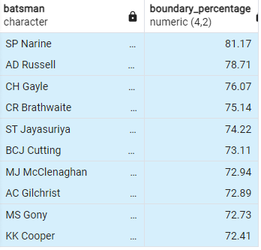
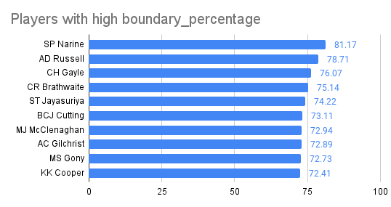
3.Now you need to get 2-3 Hard-hitting players who have scored most runs in boundaries and have played more the 2 ipl season.To do that you have to make a list of 10 players you want to bid in the auction so that when you try to grab them in auction you should not pay the amount greater than you have in the purse for a particular player.
select batsman, cast(boundary_percentage as decimal(4,2)) from( select *, (cast(boundary_runs as float)/total_runs*100) as boundary_percentage
from (SELECT batsman,total_runs, SUM(batsman_runs) AS boundary_runs,
COUNT(batsman_runs) AS boundaries_total,count(distinct extract(year from match_date)) as played_years
from (SELECT a.batsman,a.batsman_runs, SUM(a.batsman_runs) OVER (PARTITION BY a.batsman) as total_runs, b.match_date
FROM ipl_ball_data as a full join ipl_matches_data as b
on a.id=b.id) as c WHERE batsman_runs in (4,6) group by total_runs, batsman order by boundaries_total DESC ) as d
where played_years>2 order by boundary_percentage desc) as e limit 10;

Slide 7
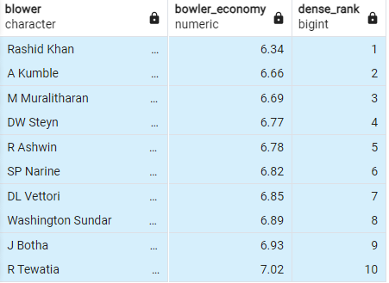
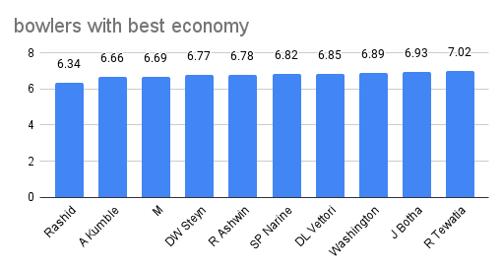
4.Your first priority is to get 2-3 bowlers with good economy who have bowled at least 500 balls in IPL so far.To do that you have to make a list of 10 players you want to bid in the auction so that when you try to grab them in auction you should not pay the amount greater than you have in the purse for a particular player.
select blower,round((economy),2) as bowler_economy, DENSE_RANK() OVER (ORDER BY economy asc) from(
select *, overall_runs/cast(bowled_overs as decimal) as economy from(
select blower,overall_runs,bowled_balls,count(ball)/6||'.'|| count(ball)%6 as bowled_overs
from(SELECT blower, ball, sum(total_runs) over (partition by blower) as overall_runs,
count(ball) over (partition by blower) as bowled_balls, over from ipl_ball_data) as a where bowled_balls>500
group by blower,overall_runs, bowled_balls) as b) as c limit 10;

Slide 8
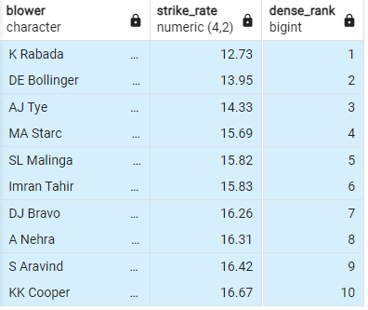
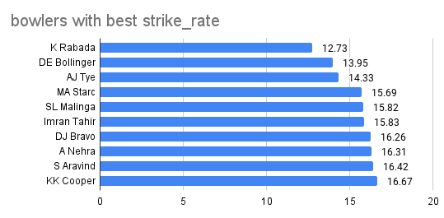
5. Now you need to get 2-3 bowlers with the best strike rate and who have bowled at least 500 balls in IPL so far.To do that you have to make a list of 10 players you want to bid in the auction so that when you try to grab them in auction you should not pay the amount greater than you have in the purse for a particular player.
select blower,cast(strike_rate as decimal(4,2)), DENSE_RANK() OVER (ORDER BY strike_rate) from (
select *, cast(total_balls as float)/wickets_taken as strike_rate from (
select blower,total_balls, sum(is_wicket) as wickets_taken from (
select blower,is_wicket, count(ball) over (partition by blower) as total_balls
from ipl_ball_data) as a where is_wicket>0 and total_balls>500
group by blower, total_balls )as b order by strike_rate asc) limit 10;

Slide 9
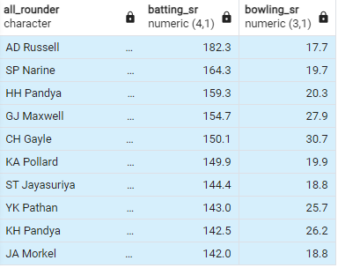
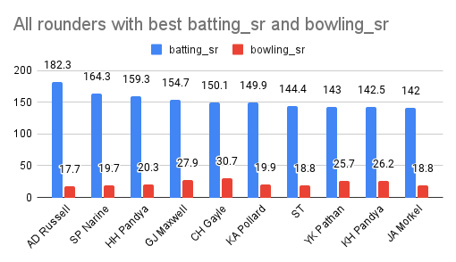
6. Now you need to get 2-3 All_rounders with the best batting as well as bowling strike rate and who have faced at least 500 balls in IPL so far and have bowled minimum 300 balls.To do that you have to make a list of 10 players you want to bid in the auction so that when you try to grab them in auction you should not pay the amount greater than you have in the purse for a particular player.
create table bat_sr as (select batsman,cast(player_total_runs as decimal)/balls_faced*100 as batting_sr from(
SELECT batsman, sum(batsman_runs) AS player_total_runs,
count(ball) AS balls_faced FROM ipl_ball_data WHERE NOT extra_type ='wides'
GROUP BY batsman having count(ball)>500) as a)
create table bowl_sr as (select blower,cast(total_balls as decimal)/wickets_taken as bowling_sr
from( select blower,total_balls,sum(is_wicket) as wickets_taken from (
select blower,is_wicket,count(ball) over (partition by blower) as total_balls from ipl_ball_data) as a
where is_wicket>0 and total_balls>300 group by blower, total_balls) as a)
MAIN QUERY:
select a.batsman as all_rounder,cast(a.batting_sr as decimal(4,1)), cast(b.bowling_sr as decimal(3,1))
from bat_sr as a inner join bowl_sr as b
on a.batsman=b.blower order by batting_sr desc,bowling_sr asc limit 10;

Slide 10
Criteria for selecting ‘Wicketkeepers’ in the Ipl :
1.Wicketkeepers have score more score quickly and need to hit boundaries.
2.Wicketkeepers should be quick , accurate stumpings and need to catches quickly.
3.They should have good feilding skills.
4.They should have good bowling economy rate.
5.They should have been played atleast 2 ipl seasons.

Slide 11
ADDITIONAL QUESTIONS:
Created the Deliveries table using Ipl_ball data:
Create table Deliveries
(id int,inning int, over int, ball int, batsman char(60),non_striker char(60),blower char(60), batsman_runs int ,extra_runs int,
total_runs int,is_wicket int, dismissal_kind char(60),player_dismissed char(60),fielder char(60),extra_type char(60),batting_team varchar(60),bowling_team varchar(60));
Coping the data from csv file:
copy Deliveries from 'C:\Program Files\PostgreSQL\16\data\new data\IPL Dataset\IPL_Ball.csv' delimiter ',' csv header;
Retrieved the data:
SELECT * FROM Deliveries;

Slide 12
Created the Matches table using Ipl_matches data:
Create table Matches
(id int, city char(60),match_date varchar(60),player_of_match char(60),venue varchar(200),neutral_venue varchar(200),team1 varchar(100),
team2 varchar(100),toss_winner varchar(100),toss_decision char(60),winner varchar(60),result varchar(60),result_margin int,
eliminator char(60),method varchar(60),umpire1 char(60),umpire2 char(60));
Coping the data from csv file:
copy Matches from 'C:\Program Files\PostgreSQL\16\data\new data\IPL Dataset\IPL_matches.csv' delimiter ',' csv header;
Retrieved the data:
SELECT * FROM Matches;

Slide 13

1.Get the count of cities that have hosted an IPL match.
SELECT COUNT(DISTINCT city) as count_of_cities from Matches;

Slide 14
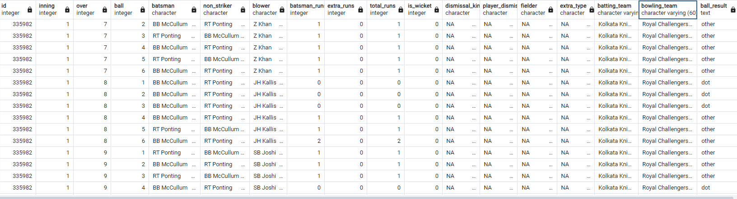
2.Create table deliveries_v02 with all the columns of the table ‘deliveries’ and an additional column ball_result containing values boundary, dot or other depending on the total_run (boundary for >= 4, dot for 0 and other for any other number).
CREATE TABLE deliveries_v02 AS
SELECT *, CASE
WHEN total_runs>=4 then 'boundary'
WHEN total_runs=0 then 'dot'
ELSE 'other'
END AS ball_result
FROM Deliveries;
SELECT * FROM deliveries_v02;

Slide 15
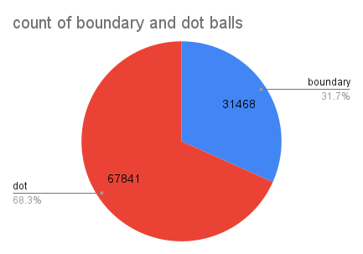

3.Write a query to fetch the total number of boundaries and dot balls from the deliveries_v02 table.
SELECT ball_result, count(ball_result) FROM deliveries_v02 WHERE ball_result='boundary' OR ball_result='dot'
GROUP BY ball_result;

Slide 16
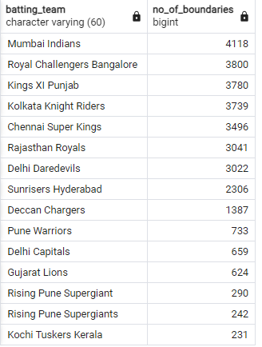
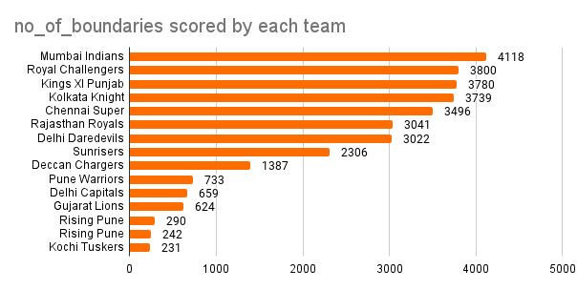
4.Write a query to fetch the total number of boundaries scored by each team from the deliveries_v02 table and order it in descending order of the number of boundaries scored.
SELECT batting_team,count(ball_result) as no_of_boundaries from deliveries_v02 WHERE
ball_result='boundary' GROUP BY batting_team ORDER BY no_of_boundaries DESC;

Slide 17
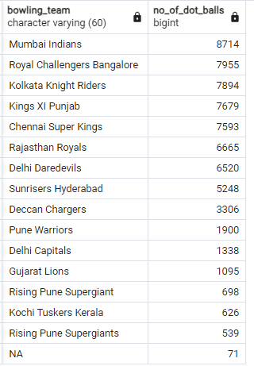
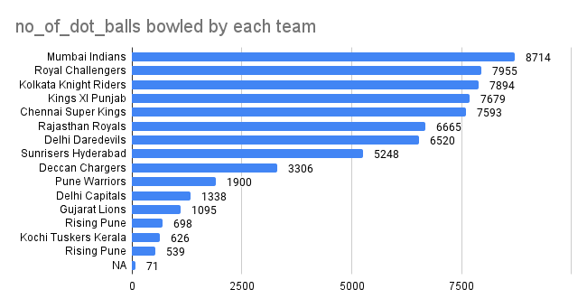
5.Write a query to fetch the total number of dot balls bowled by each team and order it in descending order of the total number of dot balls bowled.
SELECT bowling_team,count(ball_result) as no_of_dot_balls from deliveries_v02 WHERE
ball_result='dot' GROUP BY bowling_team ORDER BY no_of_dot_balls DESC;

Slide 18
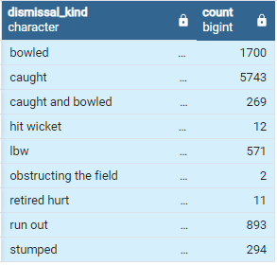
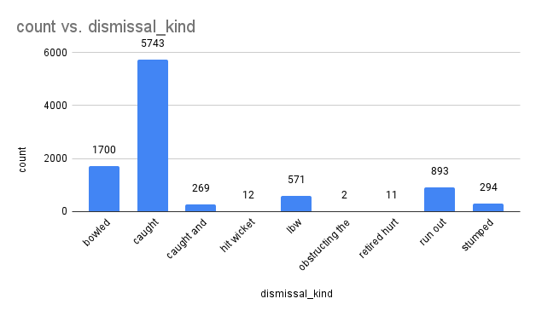
6.Write a query to fetch the total number of dismissals by dismissal kinds where dismissal kind is not NA
SELECT dismissal_kind , count(dismissal_kind) FROM deliveries_v02 WHERE not dismissal_kind='NA'
GROUP BY dismissal_kind;

Slide 19
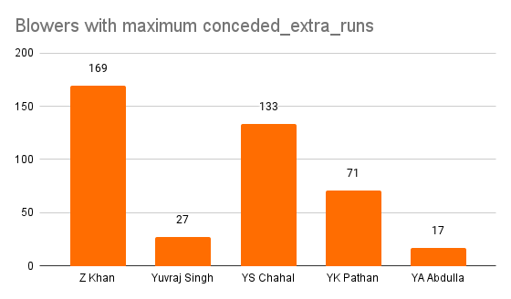
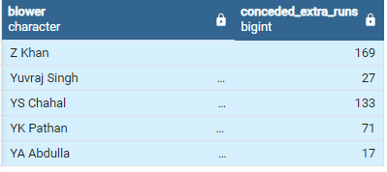
7.Write a query to get the top 5 bowlers who conceded maximum extra runs from the deliveries table.
SELECT blower,sum(extra_runs) as conceded_extra_runs FROM deliveries_v02
GROUP BY blower ORDER BY blower DESC LIMIT 5;

Slide 20
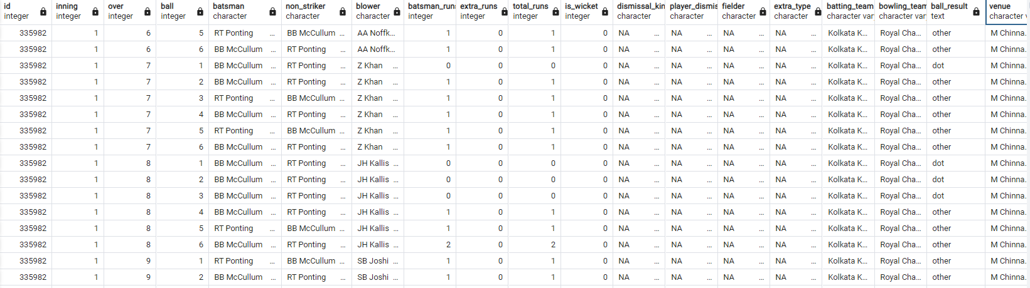

8.Write a query to create a table named deliveries_v03 with all the columns of deliveries_v02 table and two additional column (named venue and match_date) of venue and date from table matches.
CREATE TABLE deliveries_v03 as (select a.*, b.venue,b.match_date from deliveries_v02 as a
full join Matches as b on a.id=b.id);
SELECT * FROM deliveries_v03;

Slide 21
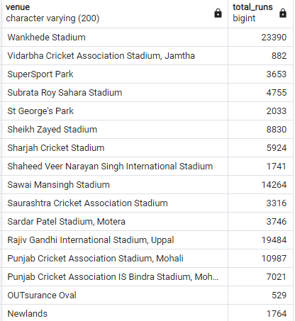
9.Write a query to fetch the total runs scored for each venue and order it in the descending order of total runs scored.
SELECT venue,sum(total_runs) as total_runs from deliveries_v03 GROUP BY venue ORDER BY venue DESC;

Slide 22
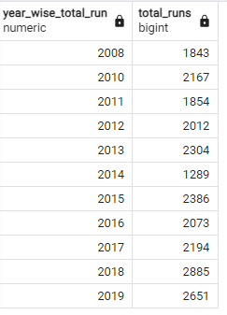
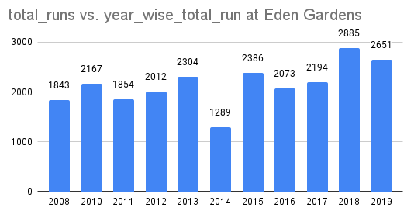
10.Write a query to fetch the year-wise total runs scored at Eden Gardens and order it in the descending order of total runs scored.
ALTER the data type of match_date:
ALTER TABLE deliveries_v03 ALTER column match_date TYPE DATE USING to_date(match_date,'DD-MM-YYYY');
Main query:
SELECT DISTINCT EXTRACT(year from match_date) as year_wise_total_run,sum(total_runs) as total_runs
from deliveries_v03 where venue='Eden Gardens' GROUP BY year_wise_total_run;

Slide 23
THANK YOU

